Slide 1
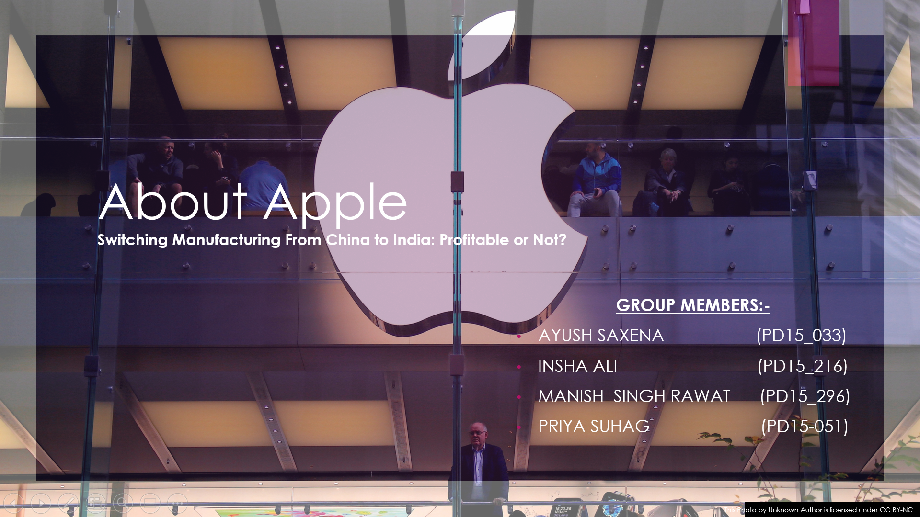

Slide 2

Outline
Introduction Of Apple
Market Share / Business Insights
Exporting and offshore assembly cost
China Established infrastructure cost
The average cost of labor in China
India’s growth rate for exporting in Asia in comparison to China
Current Manufacturing Strategy
Income and globally sales representation
Reasons to shift production from China to India
Challenges faced by the Industry in China
Conclusion
Thank You

Slide 3
Introduction
The company was founded by the late Steve Jobs, Steve Wozniak, and Ronald Wayne and was named as Apple computer company, On first April 1976 Apple was released bringing a lot of revenue and in 1980 Apple decided to go public. company’s great success was migrating the Mac OS with PowerPC.
Over the year at Apple Steve Jobs was able to build Apple into one of the greatest companies ever known. In 2001 Apple opened its first store and in 2007 it shifted its focus more to consumer electronics In 2017 Apple reported its worldwide annual revenue to be $229 billion with 123,000 employees and around 504 stores.
Apple began assembling iPhone 14 phones in India last week—the first time it’s doing so within months of the launch of a new model. The move is part of the company’s plans to diversify production, a process quickened by prolonged lockdowns in Chinese cities and tensions between Washington and Beijing. While analysts hope this will strengthen India’s position as a supplier of the premium smartphone, they also say the process will take time as it has infrastructural challenges and China has a crucial head start.

Slide 4
Market Share
According to Cybermedia Research (CMR), Apple shipped over 1.2 million iPhones in India in the second quarter, an increase of 94% year-on-year (YoY).
Apple registered a massive 48 percent growth in iPhone shipments in India in the calendar year 2021 and was on course to log a record 4.4 percent market share for the full year.
iPhone 13 is being assembled on a trial basis at the Foxconn plant in Chennai and will be available in the domestic market, as well as for exports from the country by early next year.
Apple is reportedly ramping up production of iPhones, iPods, Macs, and other devices in India and Vietnam to end its dependence on China.
Despite supply constraints, Apple has doubled its India market share in its fiscal year that ended on September 30, CEO Tim Cook has announced.
Apple had the strongest lineup in India in the past year which contributed to the growth. Apart from this, the pandemic-induced trends worked in favor of iPad, Mac, Air pod, and services growth as well in India,” Counterpoint Research Director Tarun Pathak told IANS.

Slide 5
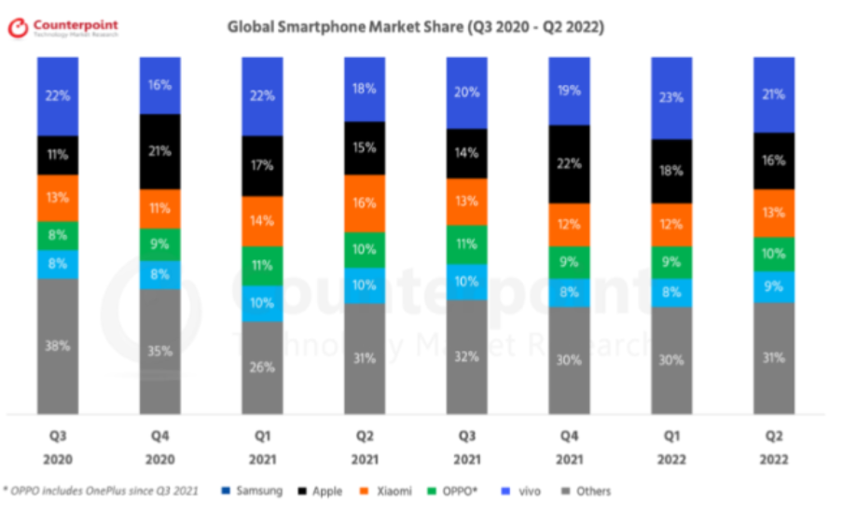
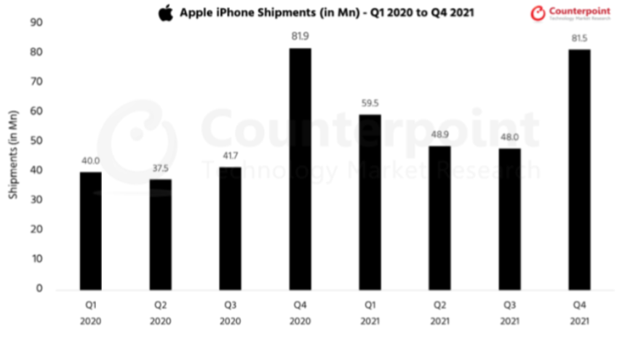
Global Market Presence and Market share: -
· Apple comes under the premium segment (>40,000) with a 45% share in this segment.
· Apple sold 237 million units of iPhones in the year 2021.
· In 2022, the premium segment was the highest-growing segment in India with 83% YoY growth.
· Apple captures around 5% of the market share among other smartphones in India.
· Premium smartphone is around 7% in India which is going to increase up to 10% by 2023.
· Premium smartphone market is growing faster than any other segment i.e., +14%.

Slide 6
Exporting and offshore assembly cost
In, cause Apple has moved its manufacturing factory from America oversees to china. But remember that unlike sharing outsourcing occurs when you take what a company was doing in-house-such as research, call centers, or accounts receivable-and have another company perform that exact same function After a decade of time in china apple decided to shift their manufacturing plant from china to India because they can diversify the manufacturing hub in ASIA region.
Several reasons are considered important for offshoring manufacturing, including low-cost labor, a stable global economy, and a rapidly growing local market
Three of Apple Inc's top contract manufacturers plan to invest a total of almost $900 million in India in the next five years
Apple Inc's top contract manufacturers—Foxconn, Wistron, and Pegatron—plan to invest a total of almost $900 million in India in the next five years to tap into a new production-linked incentive plan.
Foxconn has applied to invest about ₹4,000 crores ($542 million), while Wistron and Pegatron have committed to invest close to ₹1300 crore and ₹1200 crore, respectively, under the PLI plan, the sources said. The scheme aims to help transform India into an export manufacturing hub
Apple CEO Tim Cook said last year that he needs a “rare” combination of craftsman-like skill, sophisticated robotics, and computer science, that’s been built over time in countries like China.

Slide 7

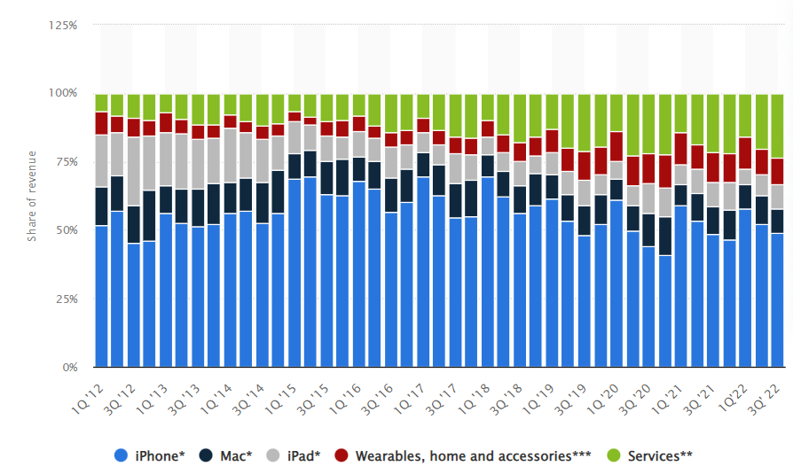
Revenue Model of Apple
Apple key statistics
Apple generated $365 billion revenue in 2021, 52% came from iPhone sales.
Apple Services was the second largest division, responsible for 18% of revenue.
230 million iPhones, 71 million iPads and 20 million Mac and MacBook units were sold in 2020.
Apple’s home and wearables division grew 25% in 2021.
It sold 110 million Air Pods and 43 million Apple Watches in 2020.
Apple Music has 72 million subscribers, Apple TV+ has over 40 million.
Share of Revenue

Slide 8
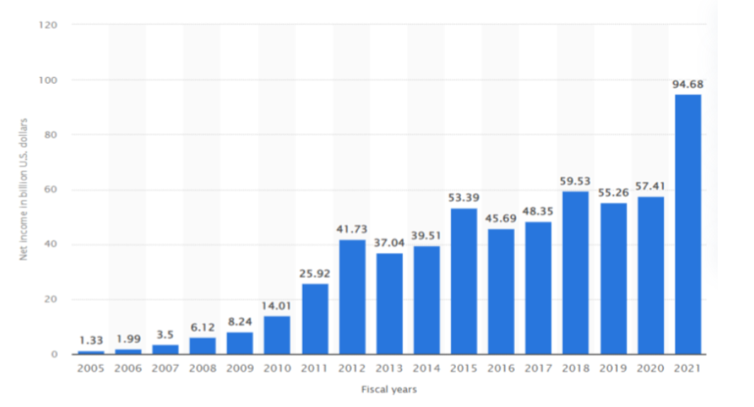
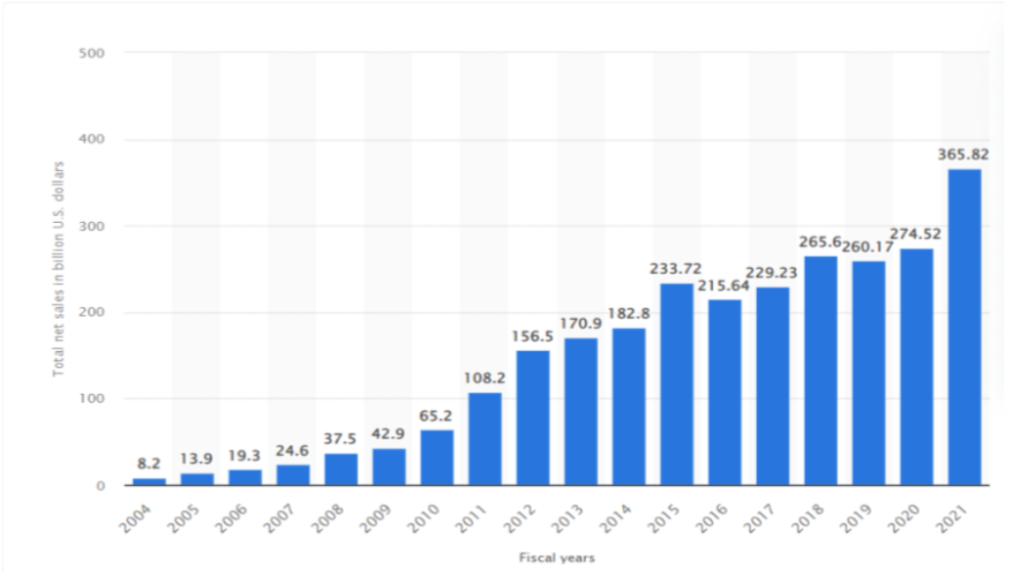
Net Income and Sales globally :-

Slide 9
China Established infrastructure cost
Apple’s iPhone is assembled in China. When an iPhone arrives in the U.S., it is recorded as an import at its factory cost of about $240, which is added to the massive U.S.-China bilateral trade deficit.
iPhone imports look like a big loss to the U.S., at least to the president, who argues that “China has been taking out $500 billion a year out of our country and rebuilding China.” One estimate suggests that imports of the iPhone 7 and 7 Plus contributed $15.7 billion to last year’s trade deficit with China. So it is estimated that for India it will be beneficial for the economy
But, as our research on the breakdown of an iPhone’s costs shows, this number does not reflect the reality of how much value China actually gets from its iPhone exports – or from many of the brand-name electronics goods it ships to the U.S. and elsewhere.
iPhone 7 a little more closely to see how much value China is actually getting.
Start with the most valuable components that make up an iPhone: the touchscreen display, memory chips, microprocessors, and so on. They come from a mix of U.S., Japanese, Korean and Taiwanese companies, such as Intel, Sony, Samsung, and Foxconn. Almost none of them are manufactured in China. Apple buys the components and has them shipped to China; then they leave China inside an iPhone.

Slide 10
The average cost of labor in China
About all of those famous factories in China with millions of workers making iPhones.
The companies that own those factories, including Foxconn, are all based in Taiwan. Of the factory-cost estimate of $237.45 from HIS Market at the time the iPhone 7 was released in late 2016, all these earned by China are about $8.46, or 3.6 percent of the total. That includes a battery supplied by a Chinese company and the labor used for assembly.
The other $228.99 goes elsewhere. The U.S. and Japan each take a roughly $68 cut, Taiwan gets about $48, and a little under $17 goes to South Korea. And we estimate that about $283 of gross profit from the retail price – about $649 for a 32GB model when the phone debuted – goes straight to Apple’s coffers.
Minimum wages have been revised in China with effect from 01 August 2021. The per month minimum wage has increased from CN¥2,200.00 (₹ 25,215) to CN¥2320.00 (₹ 26,590) and per hour minimum wage has increased from CN¥24.00 (₹ 275) to CN¥25.30 (₹ 290).
There are over 500,000 employees estimated, who are working in all the China’s manufacturing plant.
The minimum wage in India for a skilled worker is around ₹ 10,000- ₹ 12,000.

Slide 11
India’s growth rate for exporting in Asia in comparison to China
At the current rate, outbound shipments of India-made iPhones, mainly to Europe and the Middle East, are set to reach $2.5 billion in the 12 months through March 2023 Apple Inc.’s iPhone exports from India crossed $1 billion in the five months since April, according to people familiar with the matter, signalling the South Asian nation is making progress with its bid to become a force in electronics manufacturing.
At the current rate, outbound shipments of India-made iPhones, mainly to Europe and the Middle East, are set to reach $2.5 billion in the 12 months through March 2023, the people said. That’s almost double the $1.3 billion worth of iPhones India exported in the year through March 2022,
While India makes up just a small fraction of iPhone output, rising exports bode well for Prime Minister Narendra Modi’s plan to make the country an alternative to China as a factory to the world. Apple, which long made most of its iPhones in China, is seeking alternatives as Xi Jinping’s administration clashes with the US government and imposes lockdowns across the country that have disrupted.

Slide 12
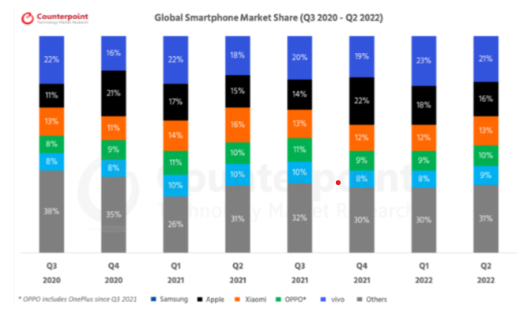
Current Manufacturing Strategy: -
Apple is going to move 5% of its global production for iPhone 14 to India by last October or early November 2022.
By 2025, it could also make up 25% of all iPhones in India. (JP Morgan)
Apple is saving 20% on import duty by manufacturing iPhone 14 in India.
Manufacturing in India will not bring the prices of iPhone 14 down as Apple’s OEM (Original Equipment Manufacturers) pay high rates of import duty on components + 18% GST + Apple’s own profit margin.

Slide 13

Reason To Shift Production From China To India
Being overly dependent on any one country is a strategic risk.
The COVID-19 pandemic originated in China and had a massive impact on manufacturing capacity.
The relationship between the US and China has often been fraught. The continued tensions mean that there is always a risk of disruptions to trade between the two countries.
It is increasingly damaging to Apple’s reputation to be so closely associated with a country that has a worsening human rights record.
Also, the increasing demand for iPhones will not be able to get completed by just manufacturing in China, as the demand is increasing year by year.

Slide 14
Challenge faced by the Industry in China (Pestle Analysis)
Political:-. A major political issue is the alarming trade war between the US and China that may impact Apple’s sales revenue and market share in China and thus it creates a risk for the company’s potential growth. So if the US tariffs will increase on Chinese imports into the US then the Chinese government will also impose heavy taxes on Apple products.
Economics:- A strong US dollar could increase exchange rates, which makes it more costly for Apple to trade in many of the principal markets like Europe and China. Also due to pandemics across the world, the economies have suffered and there have been job losses across the world. Given the high price point of Apple products, this would always be an important factor.
Social:- There is a social threat that Apple faces of opposition against its business operations. Because of the rising challenges in business disciplines, like some external repair services, Anti-Apple sentiments are arising. China’s consumers are increasingly favoring their domestic brands after the U.S. stepped up its action against Huawei, the paper said. The article cited a few anecdotes where people switched to Huawei smartphones from their beloved iPhones to show their support for the country and Chinese brands. CNBC news
Technology:- To analyze business opportunities and threats current technologies and technological advancements are assessed. One of the important factors is increasing technological integration in business which presents a growth opportunity for Apple by extending its technology services to more customers and institutions.
Environment:- This aspect highlights environmental trends and their consequences on the business. Apple manufactures the majority of its products in China where environmental side effects are a great concern and can influence manufacturing costs and regulations shortly.

Slide 15
CONCLUSION
iPhone is leading the premium smartphone segment by 45% in India which is going to grow as the GDP per capita of India will grow in the coming years.
In 2022, the premium segment was the highest-growing segment in India with 94% YoY growth.
iPhone capturing 7% smartphone market in India which is going to grow up to 10% by 2023.
By 2025, 25% of all iPhone manufacturing in the world will be from India which will make it more accessible to buy.
India’s GDP per capita for 2021 was $2,277, 17.81% as compared to the increase from 2020.
Increase in demand and increase in manufacturing will lead to an increase in the availability of iPhones in the market. The increase in the GDP per capita of India will make it easier to buy premium segment iPhones. And because there will be no drop in the prices of upcoming iPhones the major profit will still be taken by Apple which will make it more profitable in the coming years.

Slide 16
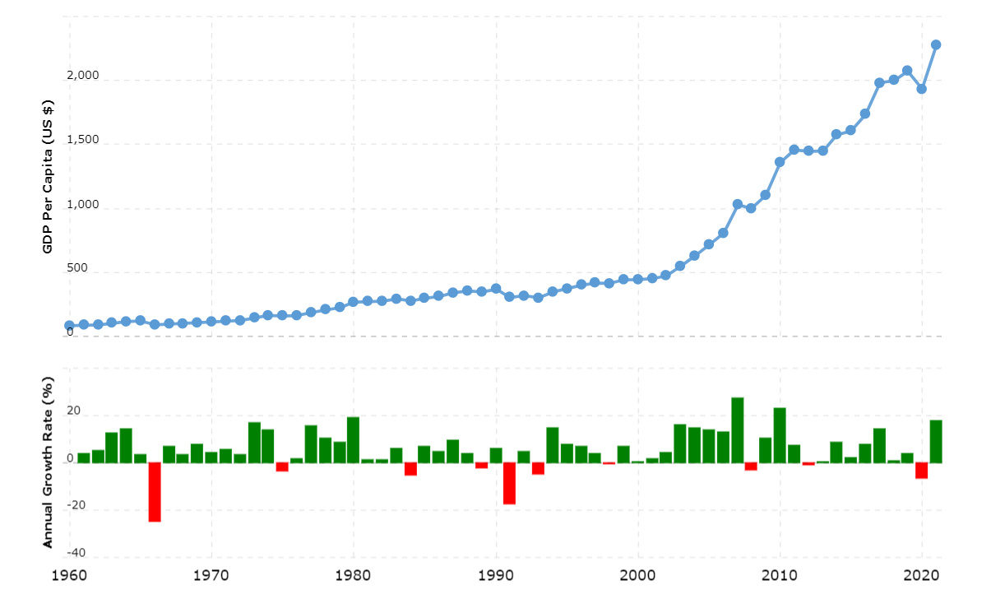
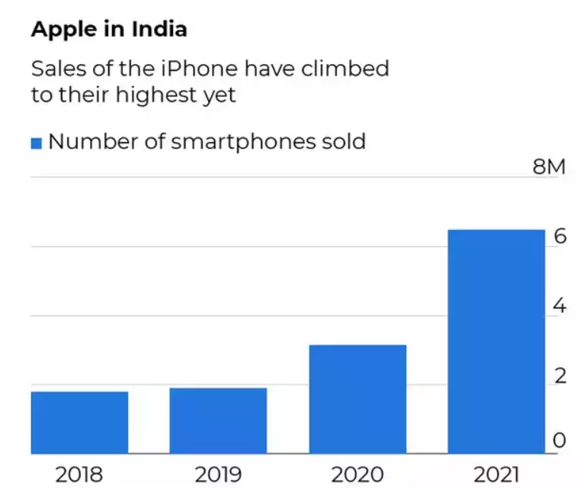
CONCLUSION
Yearly Growth of GDP per capita of India

Slide 17


